Slide 1
Understanding the enigmatic Anelloviridae
Cedric CS Tan
3rd year, BSc Molecular Biology
Supervisor: Prof. Joanne Santini

Slide 2
Contents
Introduction
The genome
Structure
Host-virus interactions
Replication
Mechanisms for accumulating genomic diversity
Potential for the emergence of infectious diseases
Transmission routes
Cross-species transmission
Risk of zoonoses
Animal reservoirs

Slide 3
I. Introduction

Slide 4
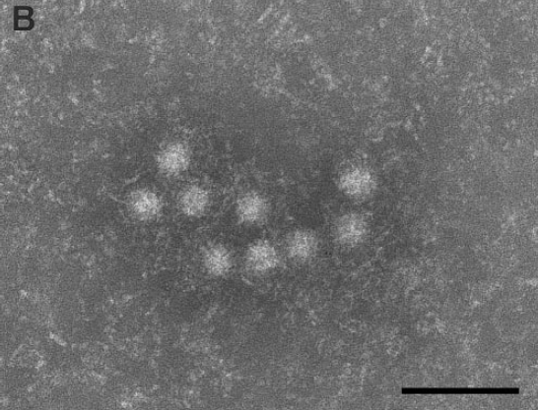
Introduction
‘Anello’ = ‘ring’
(-) ssDNA
1-4.5kb genomes
No stable cell culture system
No animal models
~30nm, non-enveloped, icosahedral capsid
100nm
Itoh et al., 2000

Slide 5


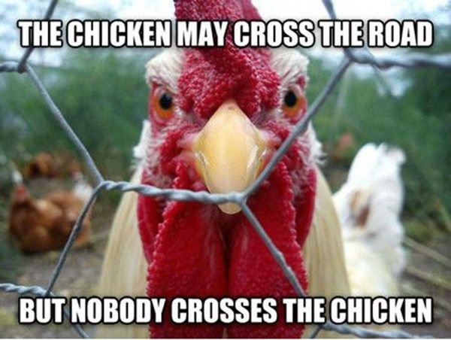
Names and Abbreviations
Torque teno virus (TTV)
Torque teno sus virus (TTSuV)
Porcine circovirus
Notes:
In this presentation I will refer to these anelloviruses by their abbreviations
They happen to also be the most studied

Slide 6
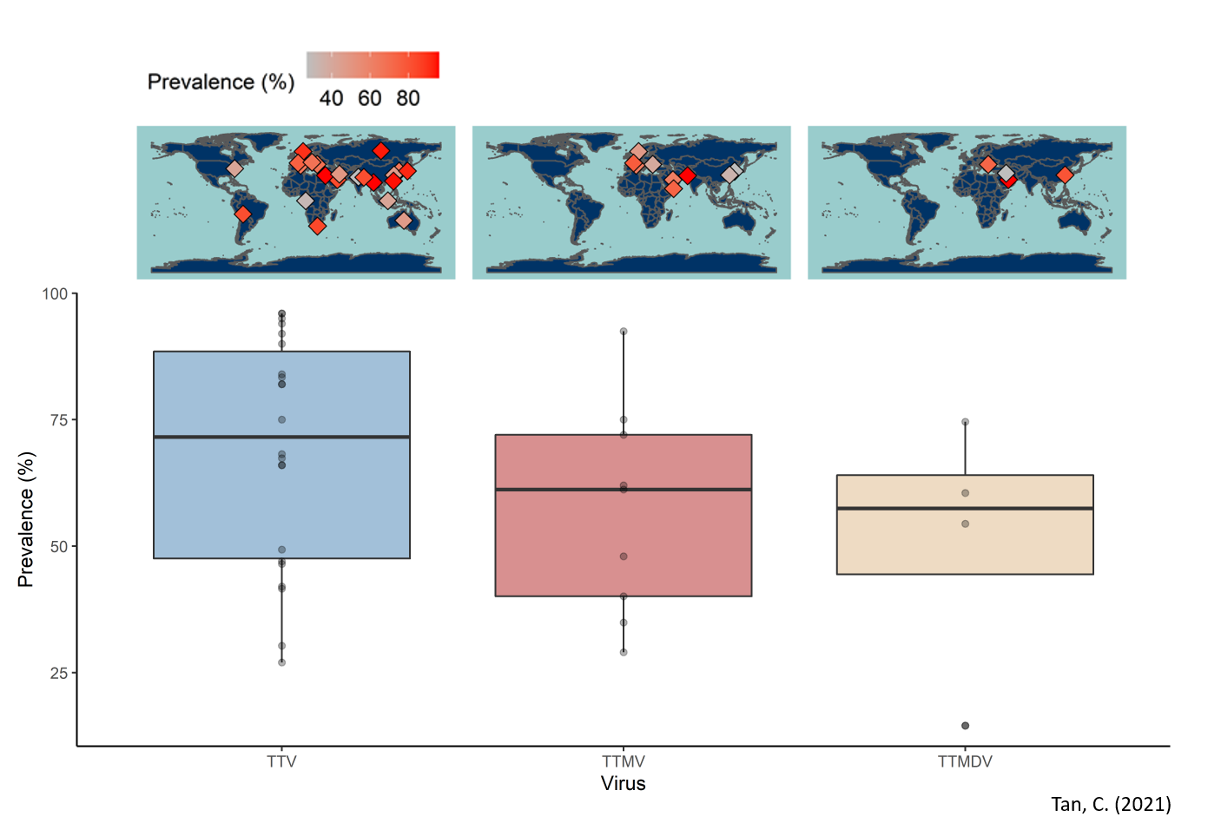
Prevalence
Notes:
I collated the prevalence estimates from 26 independent studies around the world.
This plot shows the prevalence of TTV
The highest estimate is about 96% from Myanmar

Slide 7
II. The genome

Slide 8
Genome Structure
Single polycistronic mRNA
3-4 ORFs
5-7 proteins
Alternative splicing
Alternative translation
‘Core’
Notes:
1.2kb UTR region containing a TATA box and GC-rich region and a poly A tail
ORF1 encodes the capsid with an arginine-rich N-terminus and a Rep-like protein
ORF2 encodes a dual-specificity phosphatase
ORF3 encodes an apoptosis-inducing protein

Slide 9
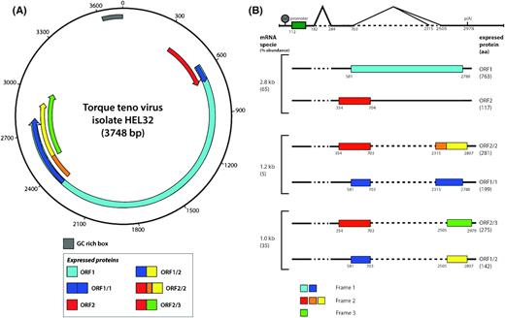
Genome structure
Alternative splicing
Kaczorowska et al., 2020
Notes:
https://doi.org/10.1093/femsre/fuaa007

Slide 10
Host-virus interactions
All TTV proteins are antigenic but infection is persistent → immune evasion
Co-infection of TTSuV with PCV causes post-weaning multisystemic wasting syndrome (PWMS)
Notes:
All six TTV proteins produced IgG responses in healthy humans, but infections are persistent

Slide 11
Immune-evasion
Modulating host gene expression (Singh and Ramamoorthy, 2016)
ORF1 upregulates suppressors of T-cell mediated immunity.
ORF2 downregulates regulators of antiviral activity and inflammation, respectively.
Inhibiting TF binding (Shulman and Davidson, 2017)
PROMO detected 44 transcription factor binding sites on TTV genome
Competitively inhibit TF binding to host genes
Nucleotide bias for immune evasion
unmethylated CpG binds TLR9 → stimulates proinflammatory gene transcription
Lower than expected CpG → reduce inflammation
Ku et al. (2020)
Notes:
First anelloviruses can alter the gene expression of host cells.
If you transfect host cells with TTSuV, suppressors of T-cell immunity are upregulated
Some regulators of antiviral activity and inflammation are downregulated.
Additionally, anelloviral genomes have evolved to mimic host TF binding sites
PROMO
Lastly, we know that unmethylated CpGs bind TLR9 in late endosomes which can inform the cell that it is infected
Anelloviral genomes may have evolved to suppress CG content

Slide 12
Immune-evasion
Modulating host gene expression (Singh and Ramamoorthy, 2016)
ORF1 upregulates suppressors of T-cell mediated immunity.
ORF2 downregulates regulators of antiviral activity and inflammation, respectively.
Inhibiting TF binding (Shulman and Davidson, 2017)
PROMO detected 44 transcription factor binding sites on TTV genome
Competitively inhibit TF binding to host genes
Nucleotide bias for immune evasion (Rocchi et al., 2009)
unmethylated CpG binds TLR9 → stimulates proinflammatory gene transcription
Lower than expected CpG → reduce inflammation
Hijacks host RNA interference pathways (Kincaid et al., 2013)
Drosha/Dicer processing
TTV miRNA loaded onto RISC
RISC degrades NMI transcript
Reduce inflammation
Ku et al. (2020)
Notes:
First anelloviruses can alter the gene expression of host cells.
If you transfect host cells with TTSuV, suppressors of T-cell immunity are upregulated
Some regulators of antiviral activity and inflammation are downregulated.
Additionally, anelloviral genomes have evolved to mimic host TF binding sites
PROMO
Next, we know that unmethylated CpGs bind TLR9 in late endosomes which can inform the cell that it is infected
Anelloviral genomes may have evolved to suppress CG content
Lastly, anelloviruses hijack host RNA interference pathways
One such pathway involves RISC, or the RNA induced silencing complex.
TTV mRNA are chopped up by drosha/dicer to produce miRNA
Loaded onto RISC as a guide
RISC has endonuclease called argonaute that digests host mRNA that is complementary to guide miRNA
(ssRNA forms stem loop dsRNA, drosha/dicer cut, one strand is digested, the other loaded)

Slide 13
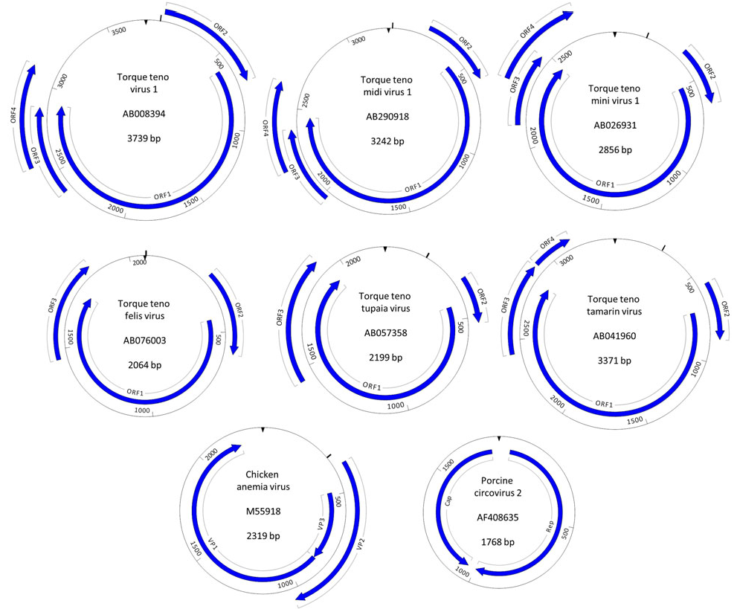
Simmonds, P. (2016)
Notes:
UTR

Slide 14
Genome Replication
Stem-loop structure
Rep-like protein
Rolling circle replication (RCR) mechanism
Notes:
Genome replication poorly understood. No direct evidence so we have to guess the replication mechanism.
Presence of stem-loop structure and Rep-like proteins found in other ssDNA families suggest RCR

Slide 15
Genome Replication
Potential mechanism
Notes:
This is a potential mechanism of RCR modelled off PCV
Starts with ssDNA
Rep protein binds the dsDNA at origin, makes single stranded nick
3’OH used by host polymerase to incorporate nucleotides
Synthesised strand displaces 5’ end of parental strand
Once one round of replication completed, Rep protein cleaves parental strand
Rep protein joins parental strand and also the synthesized strand

Slide 16
Genome Replication
Stem-loop structure
Rep-like protein
Rolling circle replication (RCR) mechanism
Notes:
Presence of stem loop conserved in other DNA replicons like phages and plasmids that replicate via RCR

Slide 17
Genome Replication
Origin-containing stem-loop
Secondary structure more important than sequence
Circovirus: Cheung, A. (2007)
Geminivirus: Orozco (1996)
RNAStructure prediction
Proposed structure
Meehan et al. (1997)
Notes:
Manual alignment finds motif similar to nonanucelotide motif containing replication origin
Conserved motifs are found in conserved stem-loop structure
Mutations that affect stem loop structure blocked replication, mutations that allowed stem-loop formation did not, which means that secondary structure is more important than sequence
So I predicted the secondary structure surrounding the motifs for TTV and CAV and compared it to that of PCV

Slide 18
Genome Replication
Stem-loop structure
Rep-like protein
FTL and YXXK motifs
Essential tyrosine
Rolling circle replication (RCR) mechanism
Notes:
Rep-like protein encoded within ORF1.
Rep-like proteins have FTL and YXXK motifs.
The Y residue in YXXK which is involved in the catalytic mechanism is also highly conserved

Slide 19
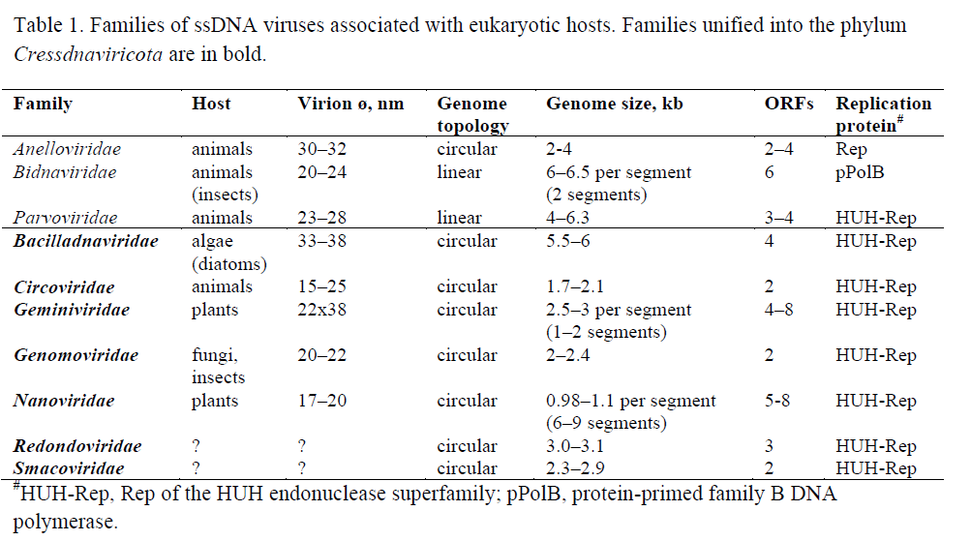
Genome Replication
Krupovic et al. (2020)
Notes:
Of 10 known eukaryotic ssDNA families, all but Bidnaviridae use Rep proteins of the HUH endonuclease superfamily
So we speculate that Anelloviridae should also be HUH endonuclease

Slide 20
Genome Replication
Proposed mechanism of Rep-like protein
Notes:
Previously I mentioned that Rep protein makes single stranded nicks at the origin and joins the DNA ring after replication
This is the proposed catalytic mechanism of the anellovirus Rep-protein when it breaks and joins ssDNA substrates.
Nucleophilic attack by essential tyrosine.
Negatively charged phosphorus intermediate stabilized by divalent metal cation (Mg2+ or Mn2+), which is coordinated by HUH motif.

Slide 21
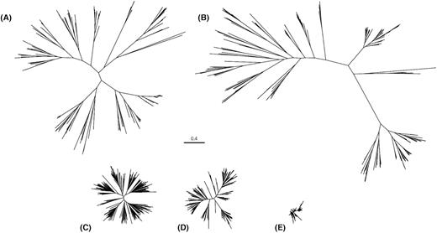
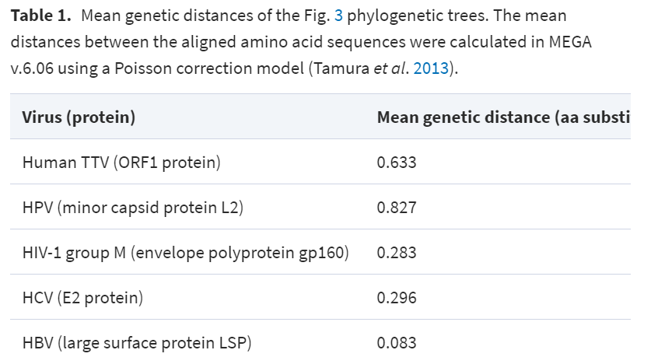
Genomic Diversity
Kaczorowska and van der Hoek (2020)
Problematic for phylogenetic reconstruction
Notes:
Just to give a rough idea of the diversity of anelloviruses, these are the phylogenies of different species of viruses.
TTV is has about 8 fold greater average sequence diversity than HBV
2 fold greater than HIV and Hepititis C
This diversity is a problem for phylogenetic reconstruction

Slide 22
Inaccurate if sequences are highly divergent
Region-restricted alignments do not capture full genomic diversity
Notes:
Typically you will use a full-genome alignment and pass it through RaxML or IQTree to reconstruct the phylogeny
However, sequence alignments are inaccurate if your sequences are highly divergent
Randomly generated sequences can have 50% seq ID if you allow gaps
So ICTV recommends that family-wide alignments should use only ORF1, which does not capture the full genomic diversity of the family.
The alternative is to use alignment-free approaches, which involves decomposition of genomes into k-mers
So I think this is the best approach for family-wide analysis of the anelloviridae
From these k-mers you compute the pairwise similarity or distances between the genomes
Then pass it into a tree-building algorithm to get your phylogeny
The problem is that there are much cooler things you can do with an alignment like inferring population dynamics or tree dating
So as a compromise we can opt for ‘Core’ genome extraction
Essentially, you extract only conserved regions of all viral genomes in the family and combine them to produce a concatenated alignment
Then you can pass the alignment into your favourite tree-building algorithm to generate your phylogeny

Slide 23
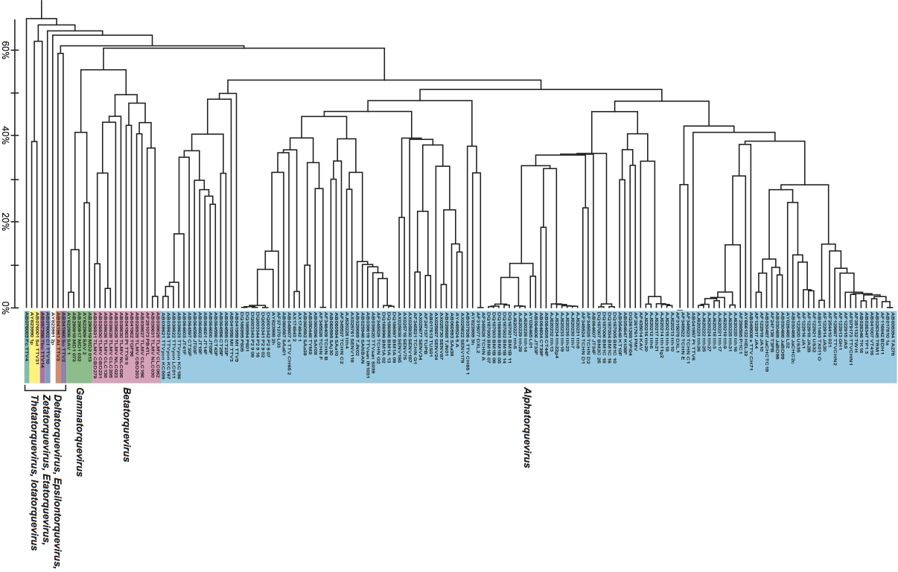
Family-wide Phylogeny
UPGMA; ORF1 (ICTV, 9th report)
Notes:
https://talk.ictvonline.org/ictv-reports/ictv_9th_report/ssdna-viruses-2011/w/ssdna_viruses/140/anelloviridae-figures

Slide 24
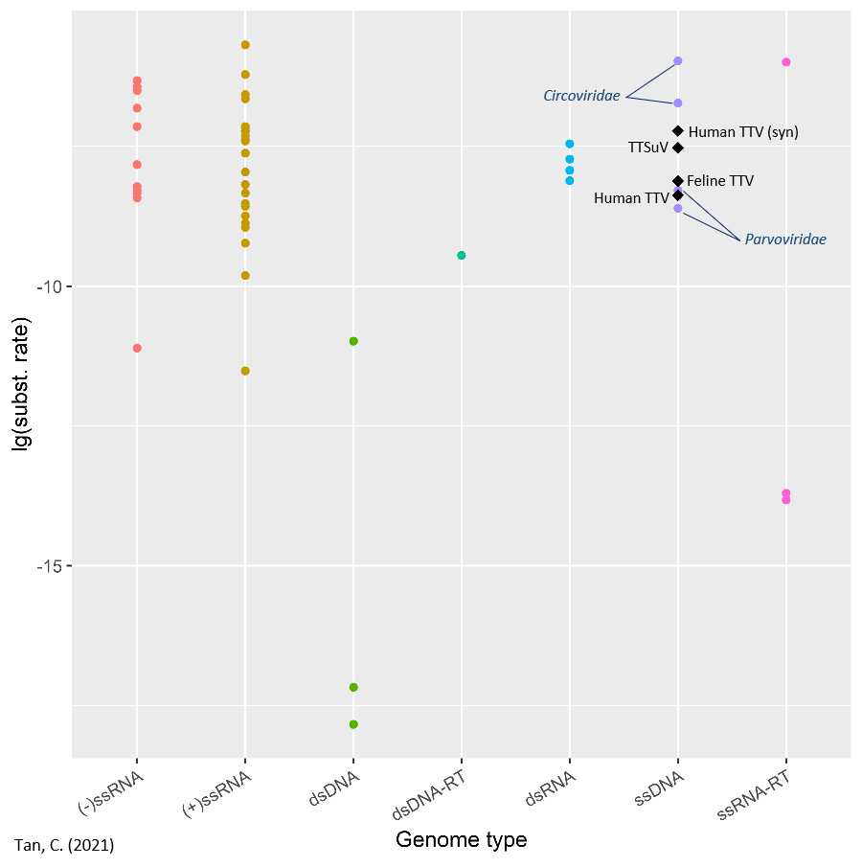
Mutation Rates
Notes:
In my review, I also looked at how fast anelloviruses mutate relative to other viruses.
Only 3 studies have tried to estimate the substitution rate of anelloviruses, which is about 10-4 subst/site/year.
This figure is a visualization of subst rates that I collated from 10 other studies.
Anelloviruses seem to have lower subst rates compared to Circoviruses but slightly higher subst rates than parvoviruses.
They also seem to have a subst rate similar to RNA viruses but have much higher subst rates than dsDNA viruses
(SARS-CoV-2 is about 6.58 * 10-3 https://onlinelibrary.wiley.com/doi/full/10.1002/jmv.25699?casa_token=PYwSGFmU_8gAAAAA%3AahVFpUrAouMw-srnVK0Ktfa5jpfmRPghFiiDNpMj69-YCMhDGS-f9tjvX_BuxvigtRKuHsaHG4oY4Lw)
(No Conf ints were shown since some use highest posterior densities, some used CI, some used Bayesian credible intervals)

Slide 25
Mutational Mechanisms
APOBEC-mediated host-editing
Recombination
Notes:
The mechanisms for which anelloviruses accumulate genomic diversity has not been studied.
Since genome replication depends on host DNA polymerase, I don’t think incorporation error is a likely driver for mutation.
I suggest two other possible drivers of mutation, which are host editing by APOBEC proteins and recombination

Slide 26
Mutational Mechanisms
APOBEC3G targets ssDNA
More C→T on 5’ end of minus strand in HIV (Yu et al. (2004))
Notes:
In mammalian hosts, APOBEC proteins function as cytidine deaminases removing amino group from Cs and converting them to Us in the template
During DNA replication, Us are base-paired with As in the complementary strand
Results in C→T and G→A hypermutation.
Host-editing has not been directly proven for anelloviruses.
However, one invitro study found that some APOBEC proteins recognize only ssDNA. The authors suggested that this single-strand specificity accounts for the higher number of C→T mutations on the 5’ end of the minus strand of HIV DNA.
It might be possible that such APOBEC proteins may also target the single stranded anelloviruses
https://www.nature.com/articles/nsmb758

Slide 27
Mutational Mechanisms
Mutations
Recombination breakpoint
Recombination
Notes:
Recombination is another possible mechanism for accumulating genomic diversity
When genomes recombine, they can form different combinations of mutations that you may not get with single point mutations alone.
(Essentially, you get to sample a larger region of the sequence space when a single recombination event occurs. )

Slide 28
Mutational Mechanisms
Recombination in anelloviruses
Found in seal, human and pig anelloviruses
89% of seal-associated anelloviruses had at least one recombination event (Fahsbender et al. (2017))
Recombination events in UTR region (Fahsbender et al. (2017))
Recombination between TTSuVs in wild boars and domestic pigs (Cadar et al. (2013))
Notes:
Recombination has been detected in seal, human and pig associated anelloviruses.
For example, Fahsbender et al. reported that 89% of seal-associated genomes had at least one recombination breakpoint
They also observed that the breakpoints tended to occur in the UTR, which is a conserved pattern amongst ssDNA viruses.
A potential reason for this is that recombinant proteins might not fold properly and therefore such recombinants are selected out.
There is a high rate of coinfection which should allows for frequent recombination.
(48% of infants showed double or triple infection with TTV, TTMV and TTMDV)

Slide 29
Mutational Mechanisms
Notes:
The fact that anelloviruses recombine is problematic of phylogenetic analysis because different parts of the recombinant genomes contain different evolutionary histories
Mixing of these evolutionary histories cannot be represented by single unipartite phylogeny.

Slide 30
III. Potential for the emergence of infectious disease

Slide 31
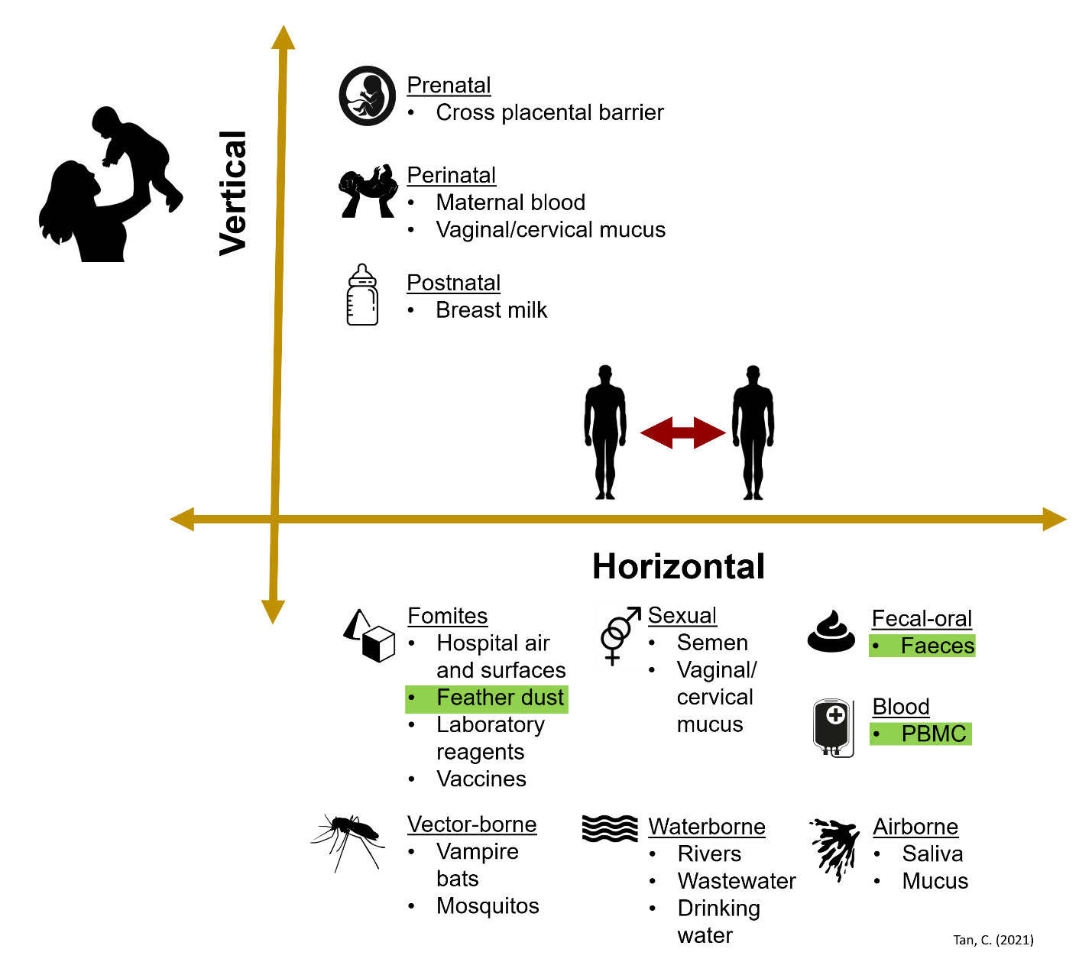
Transmission Routes
Multiple transmission routes
Pan-cellular tropism

Slide 32
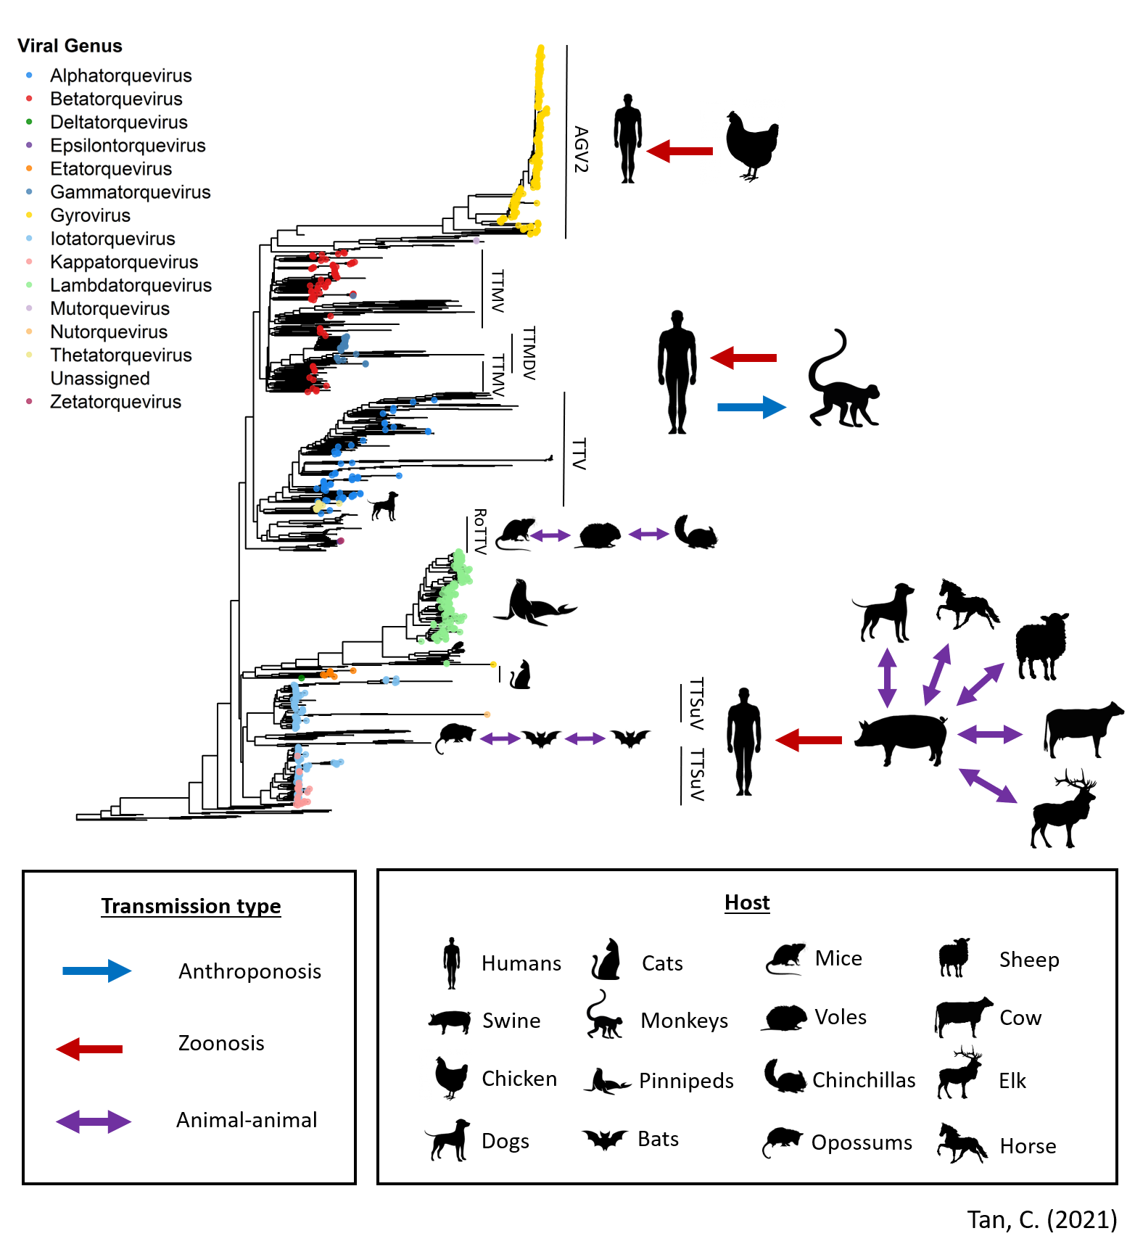
Cross-species Transmission
AGV2 and CAV in ~9% of human faecal samples (Chu et al., 2012)
Chimps and humans share TTVs (Iwaki et al., 2003)
Similar viruses isolated from opossum, fruit bat and vampire bat (de Souza et al., 2018)
TTSuV found in pigs, elks, cows, horses, dogs and humans (Singh and Ramamoorthy, 2018)
Notes:
I created a NJ tree of Mash distances for 1143 anelloviruses and annotated them with the hosts they were isolated from
I also indicate whether there is evidence for cross species transmission.
D. Rotundus and C. perspicillata share roosts

Slide 33
Cross-species Transmission
‘Generalists’
Multiple cell types
Multiple hosts
Notes:
So anelloviruses are generalists that can infect multiple cell types and can also infect multiple hosts

Slide 34
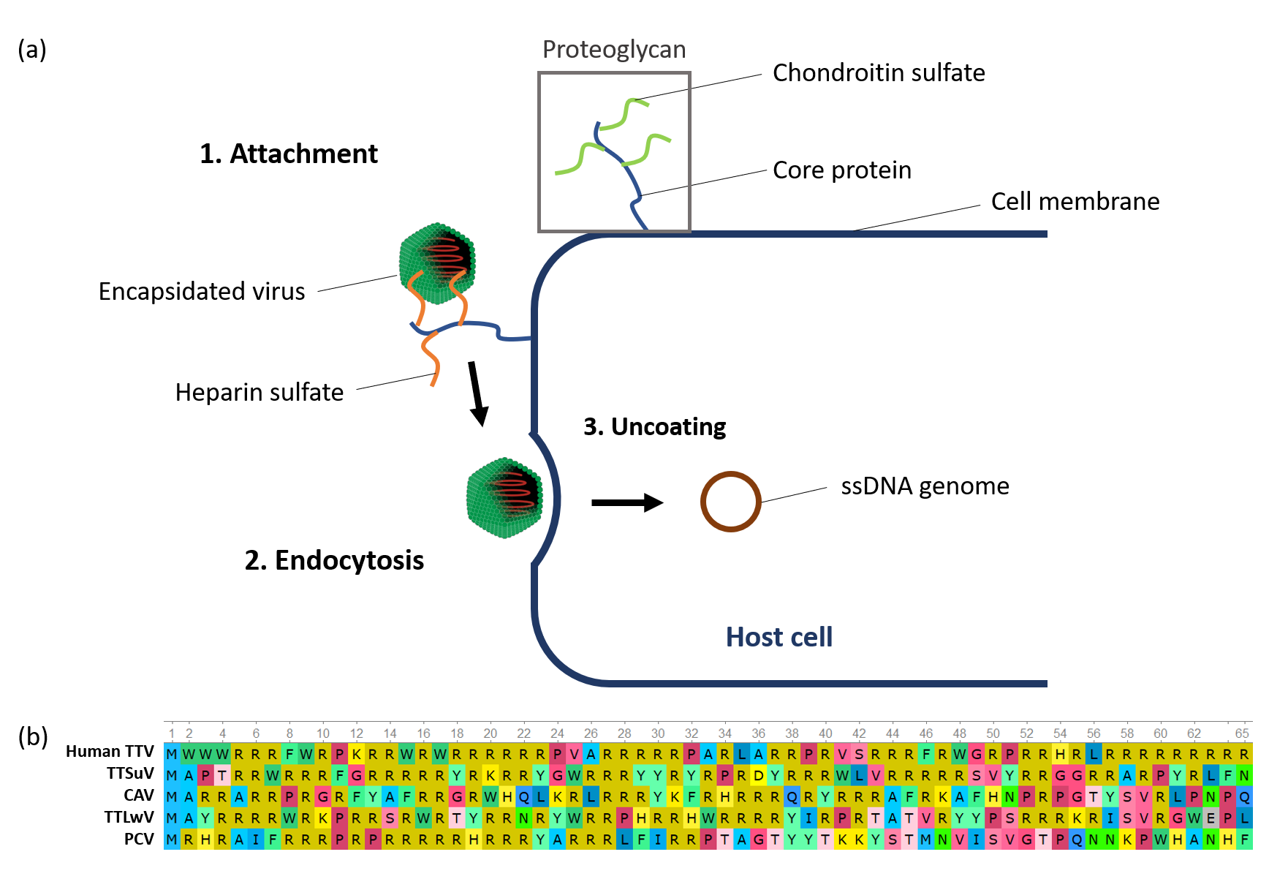
How to infect multiple hosts?
Porcine circovirus (family Circoviridae) uses proteoglycans for entry
Arginine-rich N-terminus of capsid protein binds HS/CSB receptors to trigger endocytosis (Yu et al., 2018)
Arginine-rich peptides are cell-penetrating peptides (CPPs)
First 65aa of capsid proteins
Notes:
Go back to mechanism of viral entry
Attach to cell receptors→Endocytosis→Uncoating→Release of genome
Compare to related circular ssDNA family
We know that arginine-rich N-terminus of capsid….
Particularly, the arginine-rich region is responsible for this receptor binding. They are also known as cell-penetrating peptides
Look at first 65aa of capsid proteins→ similar arigine-rich N-terminus on capsid protein
Which means AV may also use proteoglycans

Slide 35
How to infect multiple hosts?
PCV can infect HS/CSB knockout cells
Inhibit clathrin-mediated endocytosis or micropinocytosis → reduce but not abolish PCV uptake
Multiple common/conserved cell receptors + Multiple pathways → Broad host range
Notes:
Interestingly, PCV can infect…
In alpharetroviruses, a single amino acid substitution was sufficient to extend the host range from avian cell types to include human, canine, feline, and rodent cells

Slide 36
Risk of Zoonosis?
Pathogens capable of infecting multiple hosts were at least 1.29 times more likely to emerge as zoonotic infectious diseases (Cleaveland et al., 2001)
63% of zoonotic viruses found in hosts from >= 2 orders (Kreuder et al., 2015)
TTSuV-specific antibodies found in 40% of human sera (Ssemadaali et al., 2016)
Receptor binding ability
Broad host-range virus
No. of mutations
Notes:
(Cleaveland 1415 human-associated pathogens)
(Kreuder 162 zoonotic viruses)
This may be explained in part by receptor usage (only for intracellular pathogens)
If receptor binding is the first barrier to entry, viruses that already have a broad host range may require less mutations to overcome this barrier to infect humans.
In fact, TTSuV-specific antibodies have been found in human sera.

Slide 37
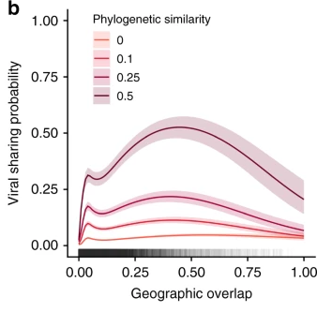
Animal Reservoirs
20% geographical overlap is required for viral sharing (Olival et al., 2017)
Maximum probability of sharing at 50% (Albery et al., 2020)
Albery et al. (2020)
Notes:
Statistical modelling studies suggest that a 20% overlap is required for viral sharing
Probability of sharing is maximum at 50%
This suggests that animals we are constantly exposed to might be suitable candidates for animal reservoirs
(Mammal sympatry calculated at 20% was always identified as significant predictor (viral richness per species ~ mammal sympatry))

Slide 38
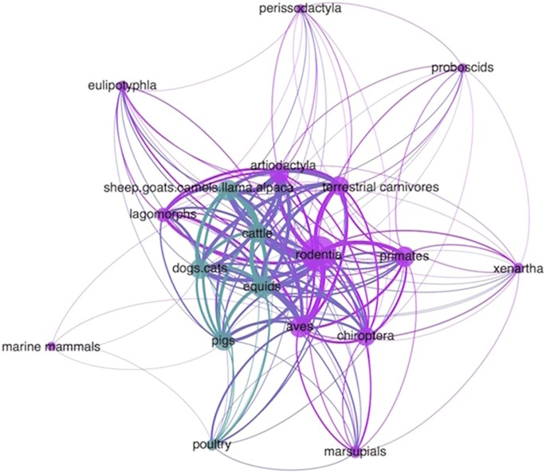
Animal Reservoirs
Animals we are frequently exposed to are key vectors
Johnson et al. (2015)
Notes:
Here Johnson et al. constructed a network of 162 viruses
Each edge represents viral sharing and each node represents a host type
The thicker the edge the more viruses shared.
Animals that we are frequently exposed to such as dogs, cats, pigs, rodents are central to network and densely connected
Suggest that they are key vectors facilitating the inflow of viruses from wild animals to humans

Slide 39


Animal reservoirs
Exposure as key risk factor for emergence
Virus
Virus
Infects new host
Zoonotic emergence
Virus
Efficient transmission
Virus
Adaptation to host
Virus
Virus goes extinct
Poor transmission
Livestock, pets, rodents or birds are potential animal reservoirs
Notes:
Exposure is a key risk factor because a virus undergoes adaptation once it acquires ability to infect new host
Some viruses don’t acquire sufficient transmission ability and are selected out.
Those that can transmit then results in zoonotic emergence.
The more frequent the exposure the more opportunity a virus has to adapt.
If this is the case, animals such as livestock, pets, rodents or birds are likely animal reservoirs that warrant further viral surveillance

Slide 40
Conclusions
Anelloviruses may not be pathogenic but may affect our immunity
Anelloviruses are highly transmissible and have a broad host-range
Anelloviruses are at a high risk of zoonotic spillover
Notes:
For example, maybe coinfection with other pathogens may result in more severe disease.
Anelloviruses are everywhere and are at a high risk of zoonotic spillover.
I think currently global health efforts are focused on damage control when a pandemic virus appears.
We should spend more resources on mitigating and pre-empting the next pandemic.

Slide 41
Nomenclature
Alpha → Torque teno
Beta → Torque teno mini
Gamma → Torque teno midi
Delta → Torque teno tupaia
Epsilon → Torque teno tamarin
Zeta → Torque teno douroucouli
Eta → Torque teno felis
Theta → Torque teno canis
Iota → Torque teno sus
Kappa → Torque teno sus virus K2
Lambda → Torque teno zalophus
Mu → Torque teno equus
Nu → Torque teno seal
Notes:
https://talk.ictvonline.org/ictv-reports/ictv_9th_report/ssdna-viruses-2011/w/ssdna_viruses/140/anelloviridae-figures

Slide 42
Host Range and Animal Reservoirs
De Souza et al. (2018)
Rodents (Criticidae)
Bats (Molossidae, Phyllostomidae)
Opossums (Didelphidae)
Nishiyama et al. (2014)
wood mice (Apodemus sylvaticus)
field voles (Microtus agrestis)
bank voles (Myodes glareolus)
Absent in Mus musculus
Notes:
https://www.sciencedirect.com/science/article/pii/S0042682217303732
https://pubmed.ncbi.nlm.nih.gov/24744300/
Methods for determining host range (one virus multiple hosts)

Slide 43
Host Range and Animal Reservoirs
Ng et al. (2009)
Sea lions (Zalophus californianus)
Agueda-Pinto et al. (2020)
Iberian Hares
Waits et al. (2018)
American dog ticks (Dermacentor variabilis)
Bigarre et al. (2005)
93% prevalence in French pigs
Amatya et al. (2017)
Lemur (Indri indri)
Notes:
https://www.microbiologyresearch.org/content/journal/jgv/10.1099/vir.0.008987-0
https://www.mdpi.com/1999-4915/12/3/340
https://link.springer.com/article/10.1007/s11262-017-1520-5
https://www.microbiologyresearch.org/content/journal/jgv/10.1099/vir.0.80573-0

Slide 44
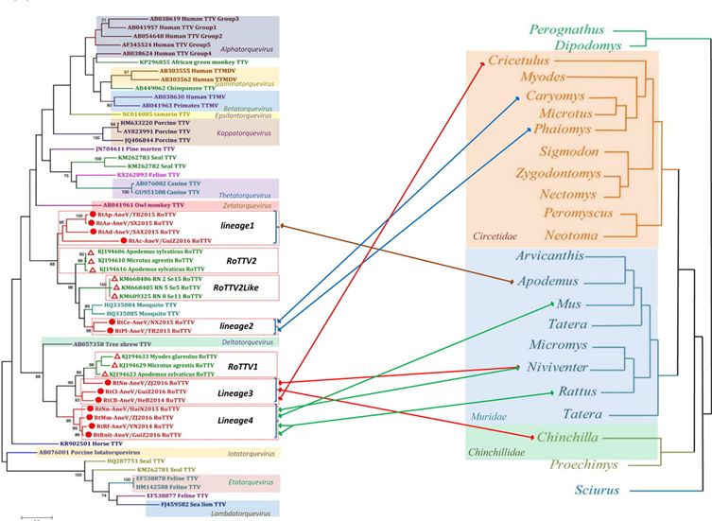
Genomic Surveillance
Du et al. (2018) collected rodents across 20 provinces in China
Du et al. (2018)
Notes:
https://www.tandfonline.com/doi/full/10.1038/s41426-018-0037-x
Look for anthroponosis

Slide 45
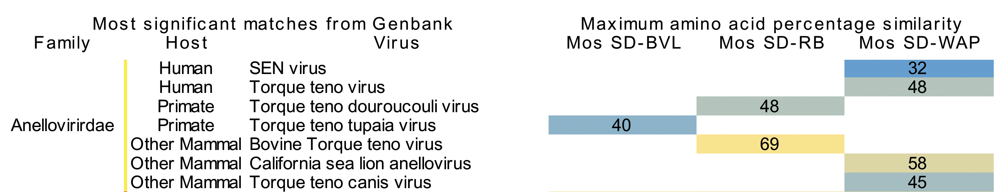
Genomic Surveillance
Modified Fig. 2
Ng et al. (2011) collected viral metagenomic samples of 3 locations in San Diego, CA
Notes:
https://journals.plos.org/plosone/article?id=10.1371/journal.pone.0020579#pone.0020579.s002

Slide 46
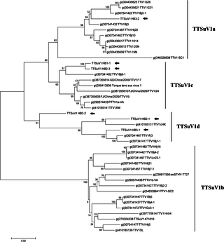

Genomic Surveillance
Shi et al. (2015) collected mosquito samples from pig farms in Hubei province, China
Potential vector for transmission of TTSuV-like viruses
Did not affirm persistence of infection in mosquitoes or transmission to humans
Notes:
https://doi.org/10.1371/journal.pone.0129845

Slide 47
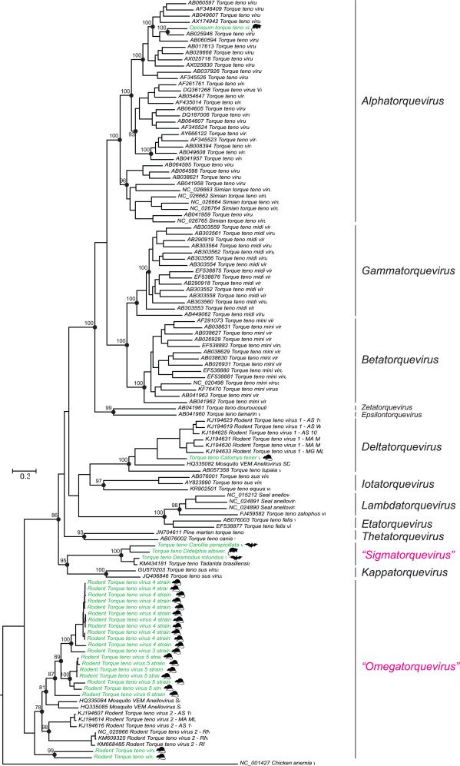

Slide 48
Zoonosis
https://www.nature.com/articles/s41598-019-42210-0
https://www.ncbi.nlm.nih.gov/pmc/articles/PMC7120144/
https://jvi.asm.org/content/80/7/3487
TTSUV found in humans https://www.nature.com/articles/srep26655

Slide 49
Zoonosis
could be spread through feather dust and dander in addition to the oral-fecal and vertical transmission routes.
https://www-sciencedirect-com.libproxy.ucl.ac.uk/science/article/pii/S0168170207004509
Human gyrovirus similar to CAV in skin https://jvi-asm-org.libproxy.ucl.ac.uk/content/85/15/7948.short
Gyrovirus in stool
https://www-sciencedirect-com.libproxy.ucl.ac.uk/science/article/pii/S1386653212002545
https://www-sciencedirect-com.libproxy.ucl.ac.uk/science/article/pii/S0042682213004935
Gyrovirus found in fowl and humans
https://www-ncbi-nlm-nih-gov.libproxy.ucl.ac.uk/pmc/articles/PMC4517707/
TTSuV in multiple hosts
https://www.sciencedirect.com/science/article/pii/S0378113517310581
Simian TTV in humans https://www.sciencedirect.com/science/article/pii/S1386634602002504?casa_token=QK3Xs9x2h0YAAAAA:XjvK71_0-ErtaYY1FiRfggoJoOEqyniHHG5ez_oLZM_yFlBofqWNQSHV-_RJNCr1_N7A5nNO3fA
https://www.ncbi.nlm.nih.gov/pmc/articles/PMC7129822/ bats-pig transmission (circovirus)
Japan wastewater TTV https://doi.org/10.1016/j.watres.2005.03.034
Human adenovirus from chimps and bonobo (recombination) https://www.ncbi.nlm.nih.gov/pmc/articles/PMC6714811/

Slide 50
ANTHROPONOSIS
Chimpanzees have been experimentally infected with human TTVs and a simian TTV was detected in a human host
chimpanzee TTVs (Pt-TTV6, s-TTV.CH65-1, s-TTV.CH65-2 and s-TTV.CH71) and chimpanzee TTMV (Pt-TTMV8-II) were interspersed with human TTVs and human TTMVs, respectively (https://www.microbiologyresearch.org/content/journal/jgv/10.1099/vir.0.007385-0).
one subject who tested positive for human TTV and TTMDV DNA was found to be co-infected with chimpanzee TTMDV
Reproducibility of the PCR assay was verified by repeated assays and the specificity of the assay was confirmed by sequence analysis of the amplicon
The present study corroborates the previous studies because human TTV sequences have been identified in samples obtained from captive chimpanzees (Cong et al., 2000; Okamoto et al., 2000a; Romeo et al., 2000),
TTV in swine and cattle
https://www.sciencedirect.com/science/article/pii/S0378113507003367#fig1

Slide 51
Pathogenicity
Seals and Sea Lions
Viral presence associated with mortality events in Sea lions (Ng et al., 2009). Found inflammation of lung tissue and high viral loads.
Pneumonia in mortality event in 21 pacific harbor seals (Ng et al. 2011).
Pigs
TTSuV + porcine circovirus 2 coinfection led to fatal postweaning multisystemic wasting syndrome. Monoinfected pigs had no clinical symptoms (Ellis et al., 2008).
Chicken
Chicken anemia virus targets erythroid and lymphoid progenitor cells in the bone marrow and thymus → severe anemia and increased mortality (Adair, 2000)
Immunosuppression (https://www-tandfonline-com.libproxy.ucl.ac.uk/doi/full/10.1080/03079450600717349)
Suboptimal protection by antibodies (https://virologyj.biomedcentral.com/articles/10.1186/1743-422X-9-189)
Notes:
https://www.microbiologyresearch.org/content/journal/jgv/10.1099/vir.0.008987-0
https://www.microbiologyresearch.org/content/journal/jgv/10.1099/vir.0.029678-0
https://doi.org/10.2460/ajvr.69.12.1608
https://www.sciencedirect.com/science/article/pii/S0145305X99000762?casa_token=lt5NOuORnCMAAAAA:W2Fn6zmYiarHxccRKf8Vu34nrtxi-XUI54IANWkz427SJkwW6HysorhmCgsjFrqpzgdU5qpij5E

Slide 52
Pathogenicity to Humans?
High TTV load (> 4 log₁₀copies/ml) associated with mortality in elderly (Hazard ratio = 4.78; Giacconi et al., 2018)
Low TTV load (< 4.2 log₁₀copies/ml) associated with kidney graft rejection within 2 years (Hazard ratio = 7.30; Solis et al., 2019)
Studies only demonstrate TTV as a marker of immune status rather than a pathogen
https://journals.plos.org/plosone/article?id=10.1371/journal.pone.0098819
APOPTIN FROM TTV https://www-microbiologyresearch-org.libproxy.ucl.ac.uk/content/journal/jgv/10.1099/vir.0.79790-0
TTV-VP3 Complements knockout CAV https://www-sciencedirect-com.libproxy.ucl.ac.uk/science/article/pii/S0042682208007113
APOPTIN does not trigger apoptosis in normal cells https://www-pnas-org.libproxy.ucl.ac.uk/content/94/11/5843.short
Notes:
https://doi.org/10.1016/j.exger.2018.09.003
10.1016/j.jinf.2019.05.010

Slide 53
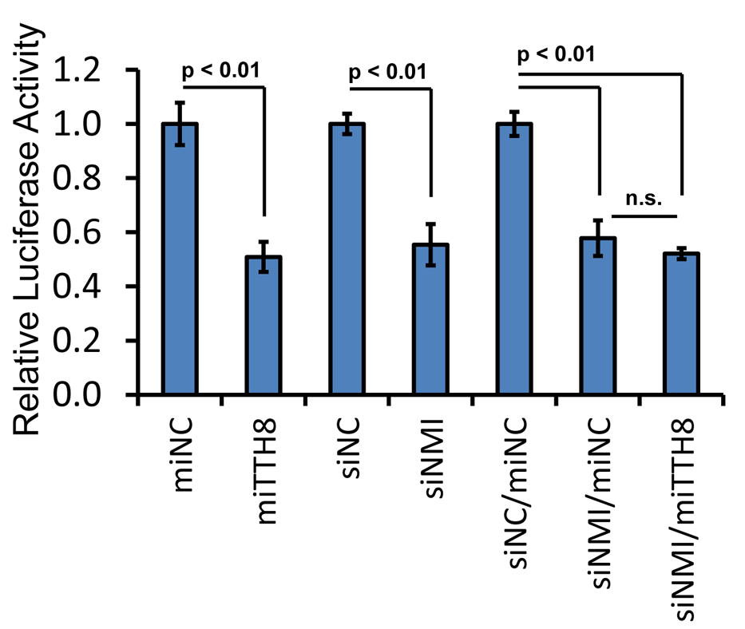
Host-Virus Interactions
TTV miRNA decreases interferon production
TTV miRNA promotes cell proliferation in response to interferon
Also, 40% decrease in ISG15
Kincaid et al., 2013
Notes:
https://journals.plos.org/plospathogens/article?id=10.1371/journal.ppat.1003818#ppat-1003818-g007
HEK293T (human embryonic kidney)

Slide 54
Host-Virus Interactions
TTV ORF2 downregulates NF-kappaB → inhibit transcription of proinflammatory IL-6, IL-8, COX-2 (Zheng et al., 2007)
TTSuV (Singh and Ramamoorthy, 2016)
Transfection of ORF1 into swine macrophage line induced early anti-viral response as part of host innate immunity
ORF1 upregulates SOCS-1, PD-1, IL-10, which are suppressors of T-cell mediated immunity
ORF2 downregulates IFN-β and IL-13, regulators of antiviral activity and inflammation, respectively
Notes:
10.1128/JVI.01101-07
https://www.sciencedirect.com/science/article/pii/S0168170216300892?casa_token=J9lhmEuHhmcAAAAA:bXpGbhNj7-3H_xnV-oWTkZyOAfhGV1iUoyEKIQMrdxO_3K40H8DFIJjybvaA1g8soD2JqNRepEQ

Slide 55
Host-Virus Interactions
https://www-sciencedirect-com.libproxy.ucl.ac.uk/science/article/pii/S0042682209005261
TLR9

Slide 56
Host-Virus Interactions
TTV isolate and look for potential binding site targets for human mRNA transcription factors using the online PROMO program, which recognizes transcription regulatory element binding sites from DNA sequences
44 dsDNA sequences, homologous to human DNA transcription regulatory protein target binding sites, were identified. Moreover, each homologous target sequence appeared multiple times (4 to 11 copies per target). Among these homologous targets on TTV-TA278 DNA were genetic elements for binding factors regulating synthesis of CREB (which plays an essential role in embryogenesis, cell differentiation, apoptosis, and proliferation), c-Jun (a proto-oncogene product with antiapoptotic activity), c-Myc (a proto-oncogene product that also regulates B cell proliferation), IRF2 (which competitively inhibits the IRF1-mediated transcriptional activation of IFNα and IFNβ), p53 (which has anticancer function and plays a role in apoptosis and genomic stability), STAT4 (which is required for the development of Th1 cells from naive CD4⁺ T cells and for IFNγ production in response to IL-12), FOXP3 (a lineage specification factor of Treg cells), and ATF3 (which represses the genes for IL-6, IL-12, and other cytokines downstream of TLR4, thereby providing a negative feedback to contain excessive inflammatory responses).

Slide 57
Lit Review Structure
Abstract
Intro
Genomic diversity of the Anelloviridae
Genome structure
Taxonomy
Mutation rate
Recombination
Host range and animal reservoirs
Host range
Pathogenicity in different hosts
Anthro
Genomic surveillance efforts
Host-pathogen interactions
Diagnostic potential of TTV
Notes:
Add interesting pointers at the start
Add mechanisms (host-pathogen)
Compare to similar mechanisms (wider phylogeny)

